Slide 1

TensorFlow Ops
CS 20: TensorFlow for Deep Learning Research
Lecture 2
1/17/2017

Slide 3
Agenda
Basic operations
Tensor types
Importing data
Lazy loading
Fun with TensorBoard!!!

Slide 4
Your first TensorFlow program
import tensorflow as tf
a = tf.constant(2) b = tf.constant(3) x = tf.add(a, b)
with tf.Session() as sess: print(sess.run(x))
Notes:
Style choice:
sess = tf.Session() instead of with tf.Session()

Slide 5
Your first TensorFlow program
import tensorflow as tf
a = tf.constant(2) b = tf.constant(3) x = tf.add(a, b)
with tf.Session() as sess: print(sess.run(x))
Warning?
The TensorFlow library wasn't compiled to use SSE4.1 instructions, but these are available on your machine and could speed up CPU computations.
Notes:
Style choice:
sess = tf.Session() instead of with tf.Session()

Slide 6
Your first TensorFlow program
import os os.environ['TF_CPP_MIN_LOG_LEVEL']='2' import tensorflow as tf a = tf.constant(2) b = tf.constant(3) x = tf.add(a, b)
with tf.Session() as sess: print(sess.run(x))
No more warning
Notes:
Style choice:
sess = tf.Session() instead of with tf.Session()

Slide 7
Visualize it with TensorBoard
import tensorflow as tf
a = tf.constant(2) b = tf.constant(3) x = tf.add(a, b)
writer = tf.summary.FileWriter('./graphs', tf.get_default_graph()) with tf.Session() as sess: # writer = tf.summary.FileWriter('./graphs', sess.graph) print(sess.run(x)) writer.close() # close the writer when you’re done using it
Create the summary writer after graph definition and before running your session
‘graphs’ or any location where you want to keep your event files
Notes:
You can choose where to put your files. I find it easier

Slide 8
Run it
Go to terminal, run:
$ python3 [yourprogram].py $ tensorboard --logdir="./graphs" --port 6006
Then open your browser and go to: http://localhost:6006/
6006 or any port you want

Slide 9
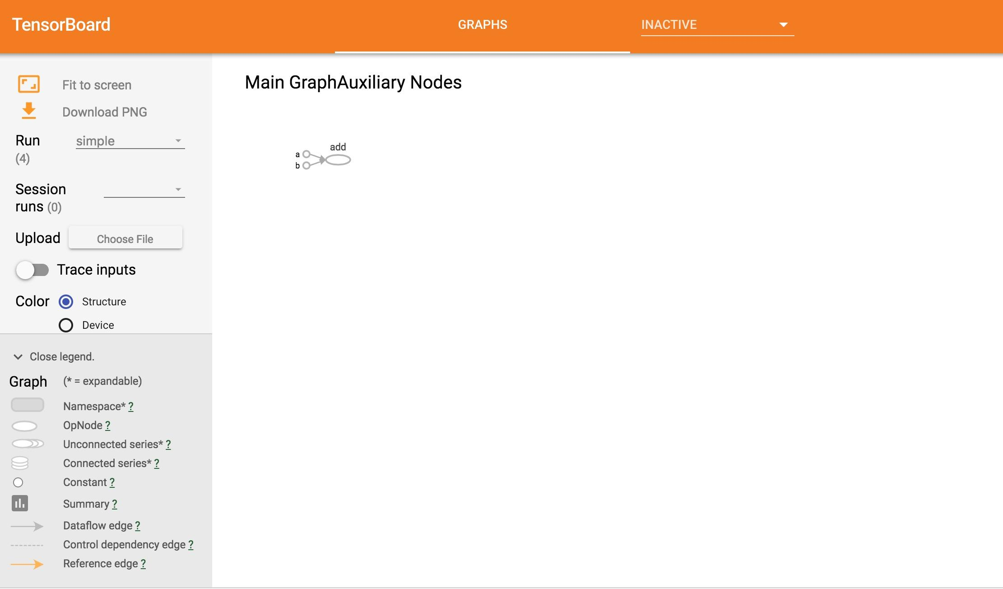
Notes:
let students look at the written graph def first (its a protobuf). show them that the values of `tf.constant()` nodes are stored in the graph def. that's why you only use constant nodes for small values (and variables or readers for larger ones)

Slide 10
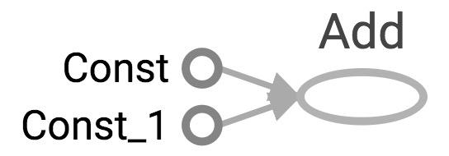
Visualize it with TensorBoard
import tensorflow as tf
a = tf.constant(2) b = tf.constant(3) x = tf.add(a, b) writer = tf.summary.FileWriter('./graphs', tf.get_default_graph()) writer.close()

Slide 11
Visualize it with TensorBoard
import tensorflow as tf
a = tf.constant(2) b = tf.constant(3) x = tf.add(a, b) writer = tf.summary.FileWriter('./graphs', tf.get_default_graph()) writer.close()
Question:
How to change Const, Const_1 to the names we give the variables?

Slide 12
Explicitly name them
import tensorflow as tf
a = tf.constant(2, name='a') b = tf.constant(3, name='b') x = tf.add(a, b, name='add')
writer = tf.summary.FileWriter('./graphs', tf.get_default_graph()) with tf.Session() as sess: print(sess.run(x)) # >> 5

Slide 13
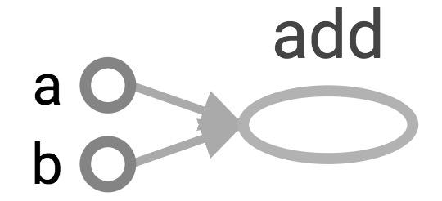
Explicitly name them
import tensorflow as tf
a = tf.constant(2, name='a') b = tf.constant(3, name='b') x = tf.add(a, b, name='add')
writer = tf.summary.FileWriter('./graphs', tf.get_default_graph()) with tf.Session() as sess: print(sess.run(x)) # >> 5

Slide 14
TensorBoard can do much more than just visualizing your graphs.
Learn to use TensorBoard
well and often!

Slide 15
Constants, Sequences, Variables, Ops

Slide 16
Constants
import tensorflow as tf
a = tf.constant([2, 2], name='a') b = tf.constant([[0, 1], [2, 3]], name='b')
tf.constant(
value,
dtype=None,
shape=None,
name='Const',
verify_shape=False
)

Slide 17
Constants
import tensorflow as tf
a = tf.constant([2, 2], name='a') b = tf.constant([[0, 1], [2, 3]], name='b') x = tf.multiply(a, b, name='mul')
with tf.Session() as sess: print(sess.run(x))
# >> [[0 2] # [4 6]]
Broadcasting similar to NumPy

Slide 18
Tensors filled with a specific value
tf.zeros(shape, dtype=tf.float32, name=None)
creates a tensor of shape and all elements will be zeros
tf.zeros([2, 3], tf.int32) ==> [[0, 0, 0], [0, 0, 0]]
Similar to numpy.zeros
Notes:
These are more compact than constants in the graph def, resulting in faster startup (especially in distributed where the graph must be send to all workers)

Slide 19
Tensors filled with a specific value
tf.zeros_like(input_tensor, dtype=None, name=None, optimize=True)
creates a tensor of shape and type (unless type is specified) as the input_tensor but all elements are zeros.
# input_tensor is [[0, 1], [2, 3], [4, 5]]
tf.zeros_like(input_tensor) ==> [[0, 0], [0, 0], [0, 0]]
Similar to numpy.zeros_like

Slide 20
Tensors filled with a specific value
tf.ones(shape, dtype=tf.float32, name=None)
tf.ones_like(input_tensor, dtype=None, name=None, optimize=True)
Similar to numpy.ones, numpy.ones_like

Slide 21
Tensors filled with a specific value
tf.fill(dims, value, name=None)
creates a tensor filled with a scalar value.
tf.fill([2, 3], 8) ==> [[8, 8, 8], [8, 8, 8]]
Similar to NumPy.full

Slide 22
Constants as sequences
tf.lin_space(start, stop, num, name=None) tf.lin_space(10.0, 13.0, 4) ==> [10. 11. 12. 13.]
tf.range(start, limit=None, delta=1, dtype=None, name='range') tf.range(3, 18, 3) ==> [3 6 9 12 15] tf.range(5) ==> [0 1 2 3 4]
NOT THE SAME AS NUMPY SEQUENCES
Tensor objects are not iterable
for _ in tf.range(4): # TypeError
Notes:
# create a sequence of num evenly-spaced values are generated beginning at start. If num > 1, the values in the sequence increase by stop - start / num - 1, so that the last one is exactly stop.
create a sequence of numbers that begins at start and extends by increments of delta up to but not including limit

Slide 23
Randomly Generated Constants
tf.random_normal
tf.truncated_normal
tf.random_uniform
tf.random_shuffle
tf.random_crop
tf.multinomial
tf.random_gamma
Notes:
You’ll often see use of tf.truncated_normal() instead of tf.random_normal(), as it doesn’t create any values more than two standard deviations away from its mean.

Slide 24
Randomly Generated Constants
tf.set_random_seed(seed)

Slide 25
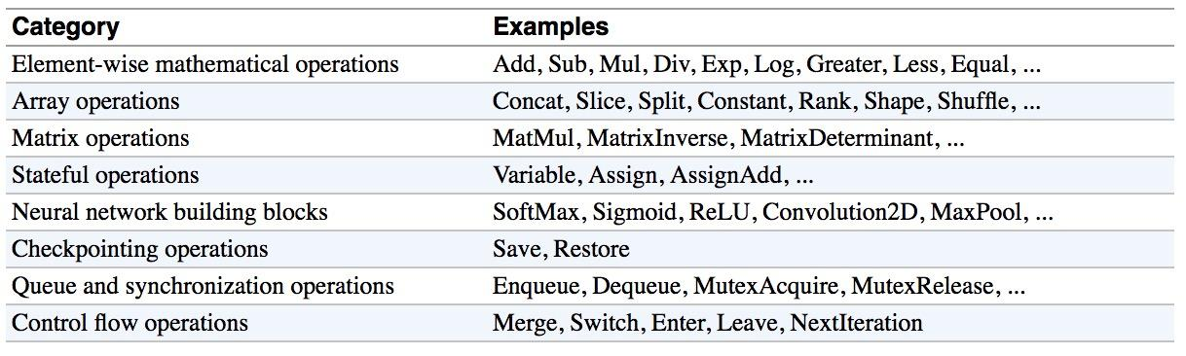
Operations
Buduma. Fundamentals of Deep Learning. O’Reilly, 2017
Notes:
Should i keep this or nah?
Not sure it adds much that isn’t already in the slides -straka

Slide 26
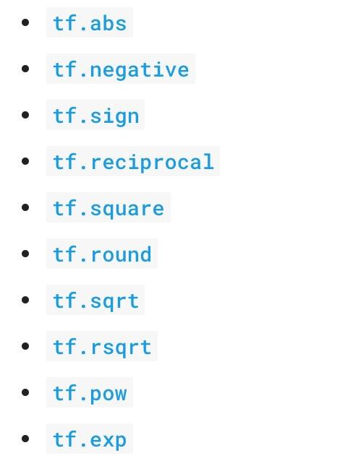
Arithmetic Ops
Pretty standard, quite similar to numpy.

Slide 27
Wizard of Div
a = tf.constant([2, 2], name='a')
b = tf.constant([[0, 1], [2, 3]], name='b')
with tf.Session() as sess:
print(sess.run(tf.div(b, a))) ⇒ [[0 0] [1 1]]
print(sess.run(tf.divide(b, a))) ⇒ [[0. 0.5] [1. 1.5]]
print(sess.run(tf.truediv(b, a))) ⇒ [[0. 0.5] [1. 1.5]]
print(sess.run(tf.floordiv(b, a))) ⇒ [[0 0] [1 1]]
print(sess.run(tf.realdiv(b, a))) ⇒ # Error: only works for real values
print(sess.run(tf.truncatediv(b, a))) ⇒ [[0 0] [1 1]]
print(sess.run(tf.floor_div(b, a))) ⇒ [[0 0] [1 1]]
Notes:
Make sure you read the documentation to understand which one to use. High level,, tf.div does TensorFlow’s style division, while tf.divide does exactly Python’s style division.

Slide 28
TensorFlow Data Types
TensorFlow takes Python natives types: boolean, numeric (int, float), strings
t_0 = 19 # scalars are treated like 0-d tensors
tf.zeros_like(t_0) # ==> 0
tf.ones_like(t_0) # ==> 1
Notes:
Single values will be converted to 0-d tensors (or scalars), lists of values will be converted to 1-d tensors (vectors), lists of lists of values will be converted to 2-d
tensors (matrices), and so on.

Slide 29
TensorFlow Data Types
TensorFlow takes Python natives types: boolean, numeric (int, float), strings
t_0 = 19 # scalars are treated like 0-d tensors
tf.zeros_like(t_0) # ==> 0
tf.ones_like(t_0) # ==> 1
Notes:
Single values will be converted to 0-d tensors (or scalars), lists of values will be converted to 1-d tensors (vectors), lists of lists of values will be converted to 2-d
tensors (matrices), and so on.

Slide 30
TensorFlow Data Types
TensorFlow takes Python natives types: boolean, numeric (int, float), strings
t_0 = 19 # scalars are treated like 0-d tensors
tf.zeros_like(t_0) # ==> 0
tf.ones_like(t_0) # ==> 1
t_1 = [b"apple", b"peach", b"grape"] # 1-d arrays are treated like 1-d tensors
tf.zeros_like(t_1) # ==> ?????
Notes:
Single values will be converted to 0-d tensors (or scalars), lists of values will be converted to 1-d tensors (vectors), lists of lists of values will be converted to 2-d
tensors (matrices), and so on.

Slide 31
TensorFlow Data Types
TensorFlow takes Python natives types: boolean, numeric (int, float), strings
t_0 = 19 # scalars are treated like 0-d tensors
tf.zeros_like(t_0) # ==> 0
tf.ones_like(t_0) # ==> 1
t_1 = [b"apple", b"peach", b"grape"] # 1-d arrays are treated like 1-d tensors
tf.zeros_like(t_1) # ==> [b'' b'' b'']
Notes:
Single values will be converted to 0-d tensors (or scalars), lists of values will be converted to 1-d tensors (vectors), lists of lists of values will be converted to 2-d
tensors (matrices), and so on.

Slide 32
TensorFlow Data Types
TensorFlow takes Python natives types: boolean, numeric (int, float), strings
t_0 = 19 # scalars are treated like 0-d tensors
tf.zeros_like(t_0) # ==> 0
tf.ones_like(t_0) # ==> 1
t_1 = [b"apple", b"peach", b"grape"] # 1-d arrays are treated like 1-d tensors
tf.zeros_like(t_1) # ==> [b'' b'' b'']
tf.ones_like(t_1) # ==> ?????
Notes:
Single values will be converted to 0-d tensors (or scalars), lists of values will be converted to 1-d tensors (vectors), lists of lists of values will be converted to 2-d
tensors (matrices), and so on.

Slide 33
TensorFlow Data Types
TensorFlow takes Python natives types: boolean, numeric (int, float), strings
t_0 = 19 # scalars are treated like 0-d tensors
tf.zeros_like(t_0) # ==> 0
tf.ones_like(t_0) # ==> 1
t_1 = [b"apple", b"peach", b"grape"] # 1-d arrays are treated like 1-d tensors
tf.zeros_like(t_1) # ==> [b'' b'' b'']
tf.ones_like(t_1) # ==> TypeError: Expected string, got 1 of type 'int' instead.
Notes:
Single values will be converted to 0-d tensors (or scalars), lists of values will be converted to 1-d tensors (vectors), lists of lists of values will be converted to 2-d
tensors (matrices), and so on.

Slide 34
TensorFlow Data Types
TensorFlow takes Python natives types: boolean, numeric (int, float), strings
t_0 = 19 # scalars are treated like 0-d tensors
tf.zeros_like(t_0) # ==> 0
tf.ones_like(t_0) # ==> 1
t_1 = [b"apple", b"peach", b"grape"] # 1-d arrays are treated like 1-d tensors
tf.zeros_like(t_1) # ==> [b'' b'' b'']
tf.ones_like(t_1) # ==> TypeError: Expected string, got 1 of type 'int' instead.
t_2 = [[True, False, False],
[False, False, True],
[False, True, False]] # 2-d arrays are treated like 2-d tensors
tf.zeros_like(t_2) # ==> ?????
tf.ones_like(t_2) # ==> ?????
Notes:
Single values will be converted to 0-d tensors (or scalars), lists of values will be converted to 1-d tensors (vectors), lists of lists of values will be converted to 2-d
tensors (matrices), and so on.

Slide 35
TensorFlow Data Types
TensorFlow takes Python natives types: boolean, numeric (int, float), strings
t_0 = 19 # scalars are treated like 0-d tensors
tf.zeros_like(t_0) # ==> 0
tf.ones_like(t_0) # ==> 1
t_1 = [b"apple", b"peach", b"grape"] # 1-d arrays are treated like 1-d tensors
tf.zeros_like(t_1) # ==> [b'' b'' b'']
tf.ones_like(t_1) # ==> TypeError: Expected string, got 1 of type 'int' instead.
t_2 = [[True, False, False],
[False, False, True],
[False, True, False]] # 2-d arrays are treated like 2-d tensors
tf.zeros_like(t_2) # ==> 3x3 tensor, all elements are False
tf.ones_like(t_2) # ==> 3x3 tensor, all elements are True
Notes:
Single values will be converted to 0-d tensors (or scalars), lists of values will be converted to 1-d tensors (vectors), lists of lists of values will be converted to 2-d
tensors (matrices), and so on.

Slide 36
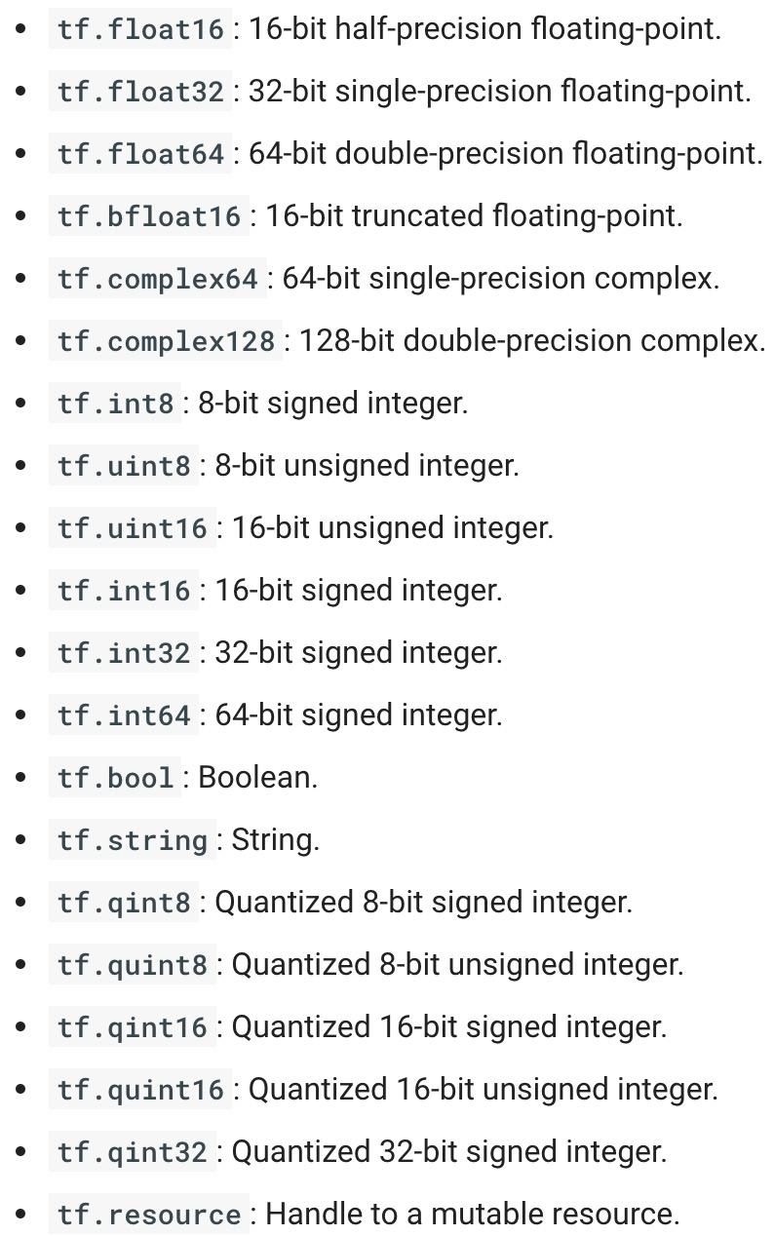
TensorFlow Data Types
Notes:
https://www.tensorflow.org/api_docs/python/tf/DType

Slide 37
TF vs NP Data Types
TensorFlow integrates seamlessly with NumPy
tf.int32 == np.int32 # ⇒ True
Can pass numpy types to TensorFlow ops
tf.ones([2, 2], np.float32) # ⇒ [[1.0 1.0], [1.0 1.0]]
For tf.Session.run(fetches): if the requested fetch is a Tensor , output will be a NumPy ndarray.
sess = tf.Session()
a = tf.zeros([2, 3], np.int32)
print(type(a)) # ⇒ <class 'tensorflow.python.framework.ops.Tensor'>
a = sess.run(a)
print(type(a)) # ⇒ <class 'numpy.ndarray'>

Slide 38
TF vs NP Data Types
TensorFlow integrates seamlessly with NumPy
tf.int32 == np.int32 # ⇒ True
Can pass numpy types to TensorFlow ops
tf.ones([2, 2], np.float32) # ⇒ [[1.0 1.0], [1.0 1.0]]
For tf.Session.run(fetches): if the requested fetch is a Tensor , output will be a NumPy ndarray.
sess = tf.Session()
a = tf.zeros([2, 3], np.int32)
print(type(a))
a = sess.run(a) <<<< Avoid doing this. Use a_out = sess.run(a)
print(type(a))

Slide 39
Use TF DType when possible
Python native types: TensorFlow has to infer Python type
Notes:
Using Python types to specify TensorFlow objects is quick and easy, and it is useful for prototyping ideas. However, there is an important pitfall in doing it this way. Python types lack the ability to explicitly state the data type, but TensorFlow’s data types are more specific. For example, all integers are the same type, but TensorFlow has 8-bit, 16-bit, 32-bit, and 64-bit integers available. Therefore, if you use a Python type, TensorFlow has to infer which data type you mean.
It’s possible to convert the data into the appropriate type when you pass it into TensorFlow, but certain data types still may be difficult to declare correctly, such as complex numbers. Because of this, it is recommended to created hand-defined Tensor objects as NumPy arrays.

Slide 40
Use TF DType when possible
Python native types: TensorFlow has to infer Python type
NumPy arrays: NumPy is not GPU compatible
Notes:
It’s possible to convert the data into the appropriate type when you pass it into TensorFlow, but certain data types still may be difficult to declare correctly, such as complex numbers. Because of this, it is recommended to created hand-defined Tensor objects as NumPy arrays.

Slide 41
What’s wrong with constants ...
… other than being constant?

Slide 42
What’s wrong with constants?
Constants are stored in the graph definition

Slide 43
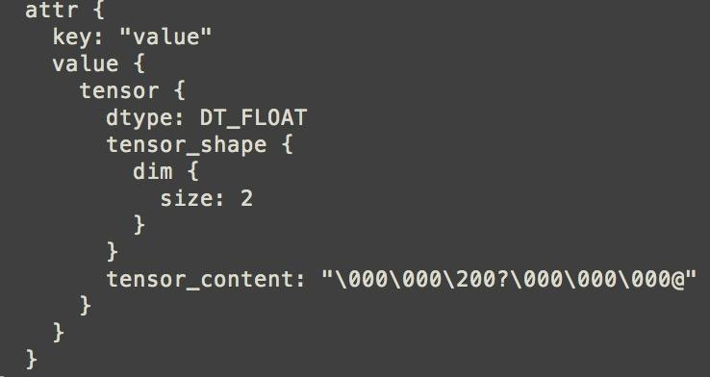
Print out the graph def
my_const = tf.constant([1.0, 2.0], name="my_const")
with tf.Session() as sess: print(sess.graph.as_graph_def())
Notes:
The graph definition is stored in a protobuf (protocol buffers, Google's language-neutral, platform-neutral, extensible mechanism for serializing structured data – think XML, but smaller, faster, and simpler.)

Slide 44
What’s wrong with constants?
This makes loading graphs expensive when constants are big

Slide 45
What’s wrong with constants?
This makes loading graphs expensive when constants are big
Only use constants for primitive types.
Use variables or readers for more data that requires more memory

Slide 46
Variables
# create variables with tf.Variable
s = tf.Variable(2, name="scalar")
m = tf.Variable([[0, 1], [2, 3]], name="matrix")
W = tf.Variable(tf.zeros([784,10]))

Slide 47
Variables
# create variables with tf.Variable
s = tf.Variable(2, name="scalar")
m = tf.Variable([[0, 1], [2, 3]], name="matrix")
W = tf.Variable(tf.zeros([784,10]))
# create variables with tf.get_variable
s = tf.get_variable("scalar", initializer=tf.constant(2))
m = tf.get_variable("matrix", initializer=tf.constant([[0, 1], [2, 3]]))
W = tf.get_variable("big_matrix", shape=(784, 10), initializer=tf.zeros_initializer())

Slide 48


Variables
# create variables with tf.Variable
s = tf.Variable(2, name="scalar")
m = tf.Variable([[0, 1], [2, 3]], name="matrix")
W = tf.Variable(tf.zeros([784,10]))
# create variables with tf.get_variable
s = tf.get_variable("scalar", initializer=tf.constant(2))
m = tf.get_variable("matrix", initializer=tf.constant([[0, 1], [2, 3]]))
W = tf.get_variable("big_matrix", shape=(784, 10), initializer=tf.zeros_initializer())

Slide 49
Variables
# create variables with tf.Variable
s = tf.Variable(2, name="scalar")
m = tf.Variable([[0, 1], [2, 3]], name="matrix")
W = tf.Variable(tf.zeros([784,10]))
# create variables with tf.get_variable
s = tf.get_variable("scalar", initializer=tf.constant(2))
m = tf.get_variable("matrix", initializer=tf.constant([[0, 1], [2, 3]]))
W = tf.get_variable("big_matrix", shape=(784, 10), initializer=tf.zeros_initializer())
Why tf.constant but tf.Variable?

Slide 50
Variables
# create variables with tf.Variable
s = tf.Variable(2, name="scalar")
m = tf.Variable([[0, 1], [2, 3]], name="matrix")
W = tf.Variable(tf.zeros([784,10]))
# create variables with tf.get_variable
s = tf.get_variable("scalar", initializer=tf.constant(2))
m = tf.get_variable("matrix", initializer=tf.constant([[0, 1], [2, 3]]))
W = tf.get_variable("big_matrix", shape=(784, 10), initializer=tf.zeros_initializer())
tf.constant is an op
tf.Variable is a class with many ops

Slide 51
tf.Variable class
# create variables with tf.get_variable
s = tf.get_variable("scalar", initializer=tf.constant(2))
m = tf.get_variable("matrix", initializer=tf.constant([[0, 1], [2, 3]]))
W = tf.get_variable("big_matrix", shape=(784, 10), initializer=tf.zeros_initializer())
tf.Variable holds several ops:
x = tf.Variable(...)
x.initializer # init op
x.value() # read op
x.assign(...) # write op
x.assign_add(...) # and more
Notes:
As a shortcut, TF allows you to omit the `.value` in many cases, so you can pass values of vars to other ops as tf.add(x, ...) rather than tf.add(x.value, ...).

Slide 52
tf.Variable class
# create variables with tf.get_variable
s = tf.get_variable("scalar", initializer=tf.constant(2))
m = tf.get_variable("matrix", initializer=tf.constant([[0, 1], [2, 3]]))
W = tf.get_variable("big_matrix", shape=(784, 10), initializer=tf.zeros_initializer())
with tf.Session() as sess: print(sess.run(W)) >> FailedPreconditionError: Attempting to use uninitialized value Variable

Slide 53
You have to initialize your variables
The easiest way is initializing all variables at once:
with tf.Session() as sess:
sess.run(tf.global_variables_initializer())
Initializer is an op. You need to execute it within the context of a session

Slide 54
You have to initialize your variables
The easiest way is initializing all variables at once:
with tf.Session() as sess:
sess.run(tf.global_variables_initializer())
Initialize only a subset of variables:
with tf.Session() as sess:
sess.run(tf.variables_initializer([a, b]))

Slide 55
You have to initialize your variables
The easiest way is initializing all variables at once:
with tf.Session() as sess:
sess.run(tf.global_variables_initializer())
Initialize only a subset of variables:
with tf.Session() as sess:
sess.run(tf.variables_initializer([a, b]))
Initialize a single variable
W = tf.Variable(tf.zeros([784,10]))
with tf.Session() as sess:
sess.run(W.initializer)

Slide 56
Eval() a variable
# W is a random 700 x 100 variable object
W = tf.Variable(tf.truncated_normal([700, 10]))
with tf.Session() as sess:
sess.run(W.initializer)
print(W)
>> Tensor("Variable/read:0", shape=(700, 10), dtype=float32)

Slide 57
Eval() a variable
# W is a random 700 x 100 variable object
W = tf.Variable(tf.truncated_normal([700, 10]))
with tf.Session() as sess:
sess.run(W.initializer)
print(W.eval()) # Similar to print(sess.run(W))
>> [[-0.76781619 -0.67020458 1.15333688 ..., -0.98434633 -1.25692499
-0.90904623]
[-0.36763489 -0.65037876 -1.52936983 ..., 0.19320194 -0.38379928
0.44387451]
[ 0.12510735 -0.82649058 0.4321366 ..., -0.3816964 0.70466036
1.33211911]
...,
[ 0.9203397 -0.99590844 0.76853162 ..., -0.74290705 0.37568584
0.64072722]
[-0.12753558 0.52571583 1.03265858 ..., 0.59978199 -0.91293705
-0.02646019]
[ 0.19076447 -0.62968266 -1.97970271 ..., -1.48389161 0.68170643
1.46369624]]
Notes:
You have to

Slide 58
tf.Variable.assign()
W = tf.Variable(10)
W.assign(100)
with tf.Session() as sess:
sess.run(W.initializer)
print(W.eval()) # >> ????

Slide 59
tf.Variable.assign()
W = tf.Variable(10)
W.assign(100)
with tf.Session() as sess:
sess.run(W.initializer)
print(W.eval()) # >> 10
Ugh, why?

Slide 60
tf.Variable.assign()
W = tf.Variable(10)
W.assign(100)
with tf.Session() as sess:
sess.run(W.initializer)
print(W.eval()) # >> 10
W.assign(100) creates an assign op.
That op needs to be executed in a session to take effect.

Slide 61
tf.Variable.assign()
W = tf.Variable(10)
W.assign(100)
with tf.Session() as sess:
sess.run(W.initializer)
print(W.eval()) # >> 10
--------
W = tf.Variable(10)
assign_op = W.assign(100)
with tf.Session() as sess:
sess.run(W.initializer)
sess.run(assign_op)
print(W.eval()) # >> 100
Notes:
You don’t need to initialize variable because assign_op does it for you. In fact, initializer op is the assign op that assigns the variable’s initial value to the variable itself.

Slide 62
tf.Variable.assign()
# create a variable whose original value is 2
my_var = tf.Variable(2, name="my_var")
# assign a * 2 to a and call that op a_times_two
my_var_times_two = my_var.assign(2 * my_var)
with tf.Session() as sess:
sess.run(my_var.initializer)
sess.run(my_var_times_two) # >> what’s the value of my_var now?

Slide 63
tf.Variable.assign()
# create a variable whose original value is 2
my_var = tf.Variable(2, name="my_var")
# assign a * 2 to a and call that op a_times_two
my_var_times_two = my_var.assign(2 * my_var)
with tf.Session() as sess:
sess.run(my_var.initializer)
sess.run(my_var_times_two) # >> the value of my_var now is 4
sess.run(my_var_times_two) # >> the value of my_var now is ???

Slide 64
tf.Variable.assign()
# create a variable whose original value is 2
my_var = tf.Variable(2, name="my_var")
# assign a * 2 to a and call that op a_times_two
my_var_times_two = my_var.assign(2 * my_var)
with tf.Session() as sess:
sess.run(my_var.initializer)
sess.run(my_var_times_two) # >> the value of my_var now is 4
sess.run(my_var_times_two) # >> the value of my_var now is 8
sess.run(my_var_times_two) # >> the value of my_var now is 16
It assign 2 * my_var to my_var every time my_var_times_two op is executed.

Slide 65
assign_add() and assign_sub()
my_var = tf.Variable(10)
With tf.Session() as sess: sess.run(my_var.initializer) # increment by 10 sess.run(my_var.assign_add(10)) # >> 20
# decrement by 2 sess.run(my_var.assign_sub(2)) # >> 18
Notes:
assign_add() and assign_sub() can’t initialize the variable my_var for you because these ops need the original value of my_var

Slide 66
Each session maintains its own copy of variables
W = tf.Variable(10)
sess1 = tf.Session()
sess2 = tf.Session()
sess1.run(W.initializer)
sess2.run(W.initializer)
print(sess1.run(W.assign_add(10))) # >> 20
print(sess2.run(W.assign_sub(2))) # >> ?

Slide 67
Each session maintains its own copy of variables
W = tf.Variable(10)
sess1 = tf.Session()
sess2 = tf.Session()
sess1.run(W.initializer)
sess2.run(W.initializer)
print(sess1.run(W.assign_add(10))) # >> 20
print(sess2.run(W.assign_sub(2))) # >> 8

Slide 68
Each session maintains its own copy of variables
W = tf.Variable(10)
sess1 = tf.Session()
sess2 = tf.Session()
sess1.run(W.initializer)
sess2.run(W.initializer)
print(sess1.run(W.assign_add(10))) # >> 20
print(sess2.run(W.assign_sub(2))) # >> 8
print(sess1.run(W.assign_add(100))) # >> 120
print(sess2.run(W.assign_sub(50))) # >> -42
sess1.close()
sess2.close()

Slide 69
Control Dependencies
tf.Graph.control_dependencies(control_inputs)
# defines which ops should be run first
# your graph g have 5 ops: a, b, c, d, e
g = tf.get_default_graph()
with g.control_dependencies([a, b, c]):
# 'd' and 'e' will only run after 'a', 'b', and 'c' have executed.
d = ...
e = …
Notes:
Sometimes, we will have two more two independent ops but you’d like to specify which op should be run first, then you use tf.Graph.control_dependencies(control_inputs)

Slide 70
Getting to know each other?

Slide 71
Placeholder

Slide 72
A quick reminder
A TF program often has 2 phases:
Assemble a graph
Use a session to execute operations in the graph.

Slide 73
Placeholders
A TF program often has 2 phases:
Assemble a graph
Use a session to execute operations in the graph.
⇒ Assemble the graph first without knowing the values needed for computation

Slide 74
Placeholders
A TF program often has 2 phases:
Assemble a graph
Use a session to execute operations in the graph.
⇒ Assemble the graph first without knowing the values needed for computation
Analogy:
Define the function f(x, y) = 2 * x + y without knowing value of x or y.
x, y are placeholders for the actual values.

Slide 75
Why placeholders?
We, or our clients, can later supply their own data when they need to execute the computation.

Slide 76
Placeholders
tf.placeholder(dtype, shape=None, name=None)
# create a placeholder for a vector of 3 elements, type tf.float32
a = tf.placeholder(tf.float32, shape=[3])
b = tf.constant([5, 5, 5], tf.float32)
# use the placeholder as you would a constant or a variable
c = a + b # short for tf.add(a, b)
with tf.Session() as sess:
print(sess.run(c)) # >> ???

Slide 77
Placeholders
tf.placeholder(dtype, shape=None, name=None)
# create a placeholder for a vector of 3 elements, type tf.float32
a = tf.placeholder(tf.float32, shape=[3])
b = tf.constant([5, 5, 5], tf.float32)
# use the placeholder as you would a constant or a variable
c = a + b # short for tf.add(a, b)
with tf.Session() as sess:
print(sess.run(c)) # >> InvalidArgumentError: a doesn’t an actual value

Slide 78
Supplement the values to placeholders using a dictionary

Slide 79
Placeholders
tf.placeholder(dtype, shape=None, name=None)
# create a placeholder for a vector of 3 elements, type tf.float32
a = tf.placeholder(tf.float32, shape=[3])
b = tf.constant([5, 5, 5], tf.float32)
# use the placeholder as you would a constant or a variable
c = a + b # short for tf.add(a, b)
with tf.Session() as sess:
print(sess.run(c, feed_dict={a: [1, 2, 3]})) # the tensor a is the key, not the string ‘a’
# >> [6, 7, 8]

Slide 80
Placeholders
tf.placeholder(dtype, shape=None, name=None)
# create a placeholder for a vector of 3 elements, type tf.float32
a = tf.placeholder(tf.float32, shape=[3])
b = tf.constant([5, 5, 5], tf.float32)
# use the placeholder as you would a constant or a variable
c = a + b # short for tf.add(a, b)
with tf.Session() as sess:
print(sess.run(c, feed_dict={a: [1, 2, 3]}))
# >> [6, 7, 8]
Quirk:
shape=None means that tensor of any shape will be accepted as value for placeholder.
shape=None is easy to construct graphs, but nightmarish for debugging

Slide 81
Placeholders
tf.placeholder(dtype, shape=None, name=None)
# create a placeholder of type float 32-bit, shape is a vector of 3 elements
a = tf.placeholder(tf.float32, shape=[3])
# create a constant of type float 32-bit, shape is a vector of 3 elements
b = tf.constant([5, 5, 5], tf.float32)
# use the placeholder as you would a constant or a variable
c = a + b # Short for tf.add(a, b)
with tf.Session() as sess:
print(sess.run(c, {a: [1, 2, 3]}))
# >> [6, 7, 8]
Quirk:
shape=None also breaks all following shape inference, which makes many ops not work because they expect certain rank.
Notes:
The session will look at the graph, trying to think: hmm, how can I get the value of a, then it computes all the nodes that leads to a.

Slide 82
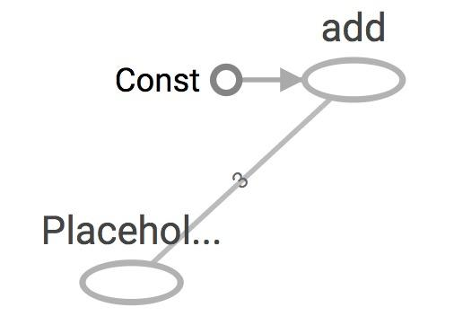
Placeholders are valid ops
tf.placeholder(dtype, shape=None, name=None)
# create a placeholder of type float 32-bit, shape is a vector of 3 elements
a = tf.placeholder(tf.float32, shape=[3])
# create a constant of type float 32-bit, shape is a vector of 3 elements
b = tf.constant([5, 5, 5], tf.float32)
# use the placeholder as you would a constant or a variable
c = a + b # Short for tf.add(a, b)
with tf.Session() as sess:
print(sess.run(c, {a: [1, 2, 3]}))
# >> [6, 7, 8]
Notes:
we can feed_dict any tensors. placeholders are just a way to indicate that sth must be fed

Slide 83
What if want to feed multiple data points in?
You have to do it one at a time
with tf.Session() as sess:
for a_value in list_of_values_for_a:
print(sess.run(c, {a: a_value}))

Slide 84
You can feed_dict any feedable tensor.
Placeholder is just a way to indicate that something must be fed

Slide 85
tf.Graph.is_feedable(tensor)
# True if and only if tensor is feedable.
Notes:
Example from GitHub

Slide 86
Feeding values to TF ops
# create operations, tensors, etc (using the default graph)
a = tf.add(2, 5)
b = tf.multiply(a, 3)
with tf.Session() as sess:
# compute the value of b given a is 15
sess.run(b, feed_dict={a: 15}) # >> 45
Notes:
The session will look at the graph, trying to think: hmm, how can I get the value of a, then it computes all the nodes that leads to a.

Slide 87
Extremely helpful for testing
Feed in dummy values to test parts of a large graph
Notes:
When you have a large graph and just want to test out certain parts, you can provide dummy values so TensorFlow won’t waste time doing unnecessary computations.

Slide 88

The trap of lazy loading*
*I might have made this term up

Slide 89
What’s lazy loading?

Slide 90
Defer creating/initializing an object
until it is needed

Slide 91
Lazy loading Example
Normal loading
x = tf.Variable(10, name='x')
y = tf.Variable(20, name='y')
z = tf.add(x, y) # create the node before executing the graph
writer = tf.summary.FileWriter('./graphs/normal_loading', tf.get_default_graph())
with tf.Session() as sess:
sess.run(tf.global_variables_initializer())
for _ in range(10):
sess.run(z)
writer.close()

Slide 92
Lazy loading Example
Lazy loading
x = tf.Variable(10, name='x')
y = tf.Variable(20, name='y')
writer = tf.summary.FileWriter('./graphs/normal_loading', tf.get_default_graph())
with tf.Session() as sess:
sess.run(tf.global_variables_initializer())
for _ in range(10):
sess.run(tf.add(x, y)) # someone decides to be clever to save one line of code
writer.close()

Slide 93
Both give the same value of z
What’s the problem?

Slide 94
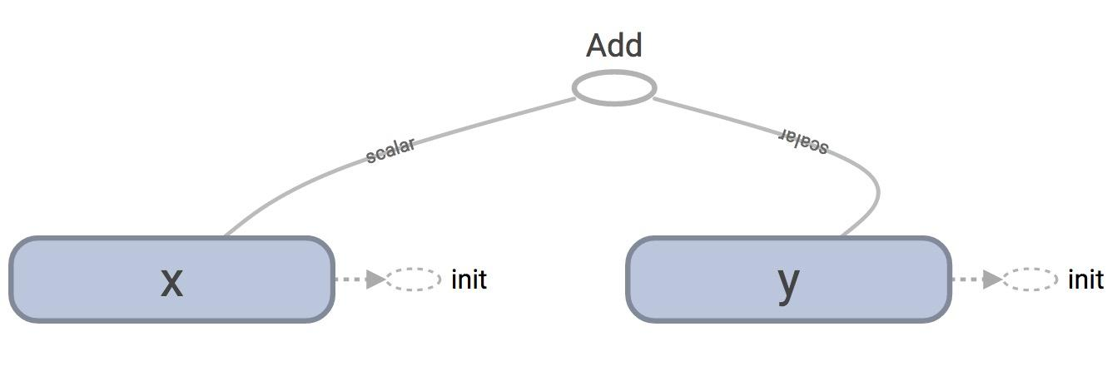
TensorBoard
Normal loading
Notes:
Looks normal

Slide 95
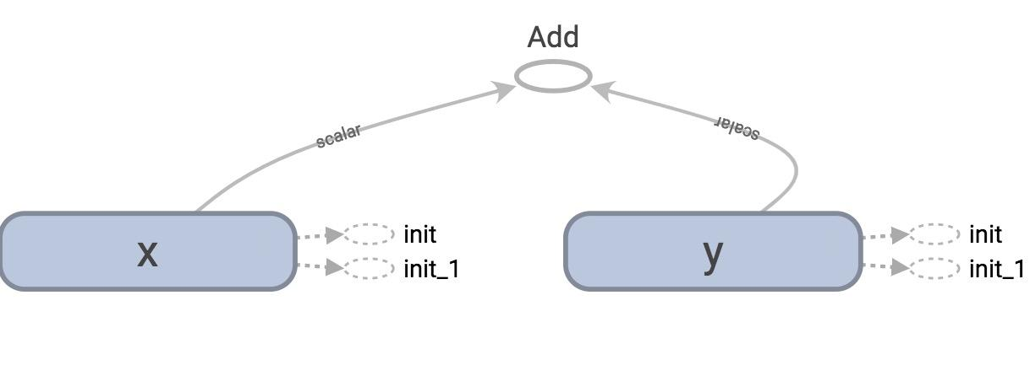
TensorBoard
Lazy loading

Slide 96
tf.get_default_graph().as_graph_def()
Normal loading
node {
name: "Add"
op: "Add"
input: "x/read"
input: "y/read"
attr {
key: "T"
value {
type: DT_INT32
}
}
}
Node “Add” added once to the graph definition
Notes:
tensorflow.python.framework.errors_impl.FailedPreconditionError: Attempting to use uninitialized value

Slide 97
tf.get_default_graph().as_graph_def()
Lazy loading
node {
name: "Add_1"
op: "Add"
...
}
...
node {
name: "Add_10"
op: "Add"
...
}
Node “Add” added 10 times to the graph definition
Or as many times as you want to compute z

Slide 98
Imagine you want to compute an op
thousands, or millions of times!
Notes:
Example from GitHub

Slide 99
Your graph gets bloated
Slow to load
Expensive to pass around
Notes:
Example from GitHub

Slide 100
One of the most common TF non-bug bugs I’ve seen on GitHub

Slide 101
Solution
Separate definition of ops from computing/running ops
Use Python property to ensure function is also loaded once the first time it is called*
* This is not a Python class so I won’t go into it here. But if you don’t know how to use this property, you’re welcome to ask me!

Slide 102
Putting it together:
Let’s build a machine learning model!
Notes:
Example from GitHub

Slide 103
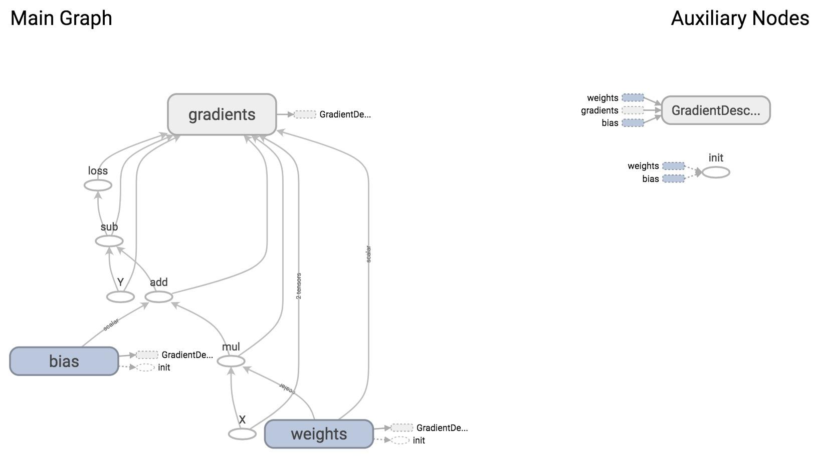
Notes:
How it looks like on TensorBoard

Slide 104
We will construct this model next time!!

Slide 105
Next class
Linear regression
Control Flow
tf.data
Optimizers
Logistic regression on MNIST
Feedback: huyenn@stanford.edu
Thanks!

